Slide 1
SPA’s vs MPA’s
10/01/2022 By Prachi Pandya
Notes:
While building a website it is essential to see the bigger picture of the whole project, thereupon it is important to understand that there are two different ways to do it. When should you use a single-page application and when should you use a multi-page application?

Slide 2
Agenda
Trivia
What is SPA?
What is MPA?
SPA vs MPA. What’s the difference?
Pros & Cons
Questions

Slide 3


Notes:
Today, the digital landscape is filled with competitiveness, and everyone is keen to provide the best UX.
Different product teams face diverse challenges – marketers need to maximize the return of investment, meaning to not end up with minimum conversions and high bounce rates; designers need to make create beautiful user interfaces across the platform; developers must build a system that withstands high-traffic volumes and reduce load-times.
From developers to marketers, everyone is trying to reduce user frustration while using the website. The frustration of the user can be defined as the following “I do not understand how to buy this product”, “I do not understand how to use this site”, and “this site is taking forever to load; therefore it does not seem trustworthy”.

Slide 4
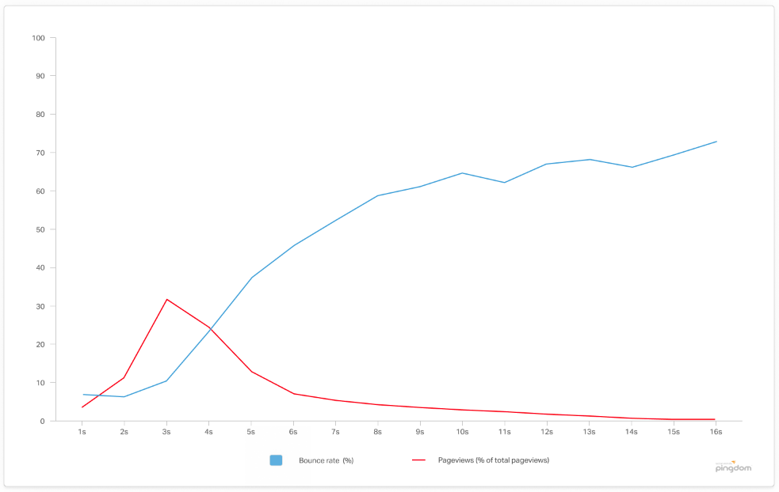
The average load time of the top-ranking websites in Google is under three seconds, and considering 57% of people leave a page that takes longer than three seconds to load, you have an enormous opportunity to increase website traffic just by increasing site speed

Slide 5
Multiple Page Application
Different to SPAs, multi-page applications (MPAs) are complex websites. To put it more simply, it is a traditional web application that reloads the entire page whenever the user interacts with the website.
Each time that the data is exchanged, the application makes a request from the server to display different information in the browser. The main reason why it differs so much from the single-page applications.
MPAs take time to execute the information exchanges, meaning that the user experience can be harmed if the servers connect slowly or the internet connection is poor.
Notes:
If you want to see an example of how multi-page applications work, head over to the websites like Amazon, eBay, or every other traditional website. You’ll notice that each time you press on the website, you’re being redirecting to another page. MPA sites consist of many micro-websites and subsections to distribute content across the platform.
Luckily, it’s not a problem anymore. Thanks to AJAX, we don’t have to worry that big and complex applications have to transfer a lot of data between server and browser. That solution improves and it allows to refresh only particular parts of the application. On the other hand, it adds more complexity and it is more difficult to develop than a single-page application.

Slide 6
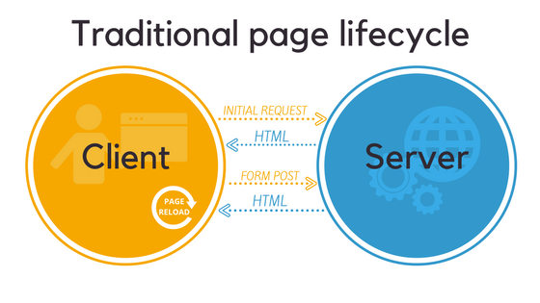
Multiple Page Application
Notes:
Explain the image
When MPAs react to your input or has to display some new content, it requests a new HTML page from the server. After receiving the markup, the browser renders the new page causing it to reload.

Slide 7
Single Page Application
A single-page application is an app that works inside a browser
It does not require page reloading during use
SPAs are all about serving an outstanding UX by trying to imitate a “natural” environment in the browser — no page reloads, no extra wait time.
It is just one web page that you visit which then loads all other content using JavaScript — which they heavily depend on.
SPA requests the markup and data independently and renders pages straight in the browser.
We can do this thanks to the advanced JavaScript frameworks like AngularJS, Ember.js, Meteor.js, Knockout.js
Single-page sites help keep the user in one, comfortable web space where content is presented to the user in a simple, easy and workable fashion.
Notes:
If you have been on platforms like Facebook, Gmail, Twitter, GitHub and so on, you have already met the best examples of SPA. It is one of its’ greatest features that when the page loads, only data is sent back-and-forth, and the website executes everything within itself rather than going through servers every time.
Angular.IO

Slide 8
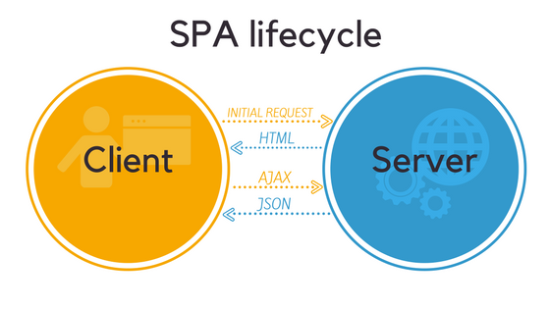
SPA vs MPA. What’s the difference?
Notes:
Explain the image
AJAX (Asynchronous JavaScript and XML) allows web applications to refresh only a part of a page.
When you interact with a SPA, your browser makes an AJAX call to the server. But instead of rendering a new page, the server can just send you the data (usually in a JSON format). The SPA will then use that data to render some parts of the page directly in your browser.
The result is an application that consists of a single highly-interactive web page that never completely reloads.
So now you know the basic difference between SPAs and MPAs, let’s dive deeper and discover their advantages and drawbacks.

Slide 9
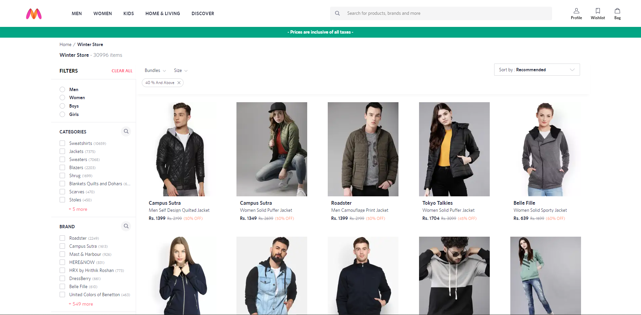
Single Page Application - Pros
Fast & Smooth UX
Headers, sidebar, and footers remain the same to save time loading the page
As you explore the page, the content changes depending upon the feature you interact with.
Only part of a page is loaded.
Notes:
It’s easy to imagine how constant full-page reloads can hurt the user experience.
You’ll never find this problem in SPAs. JavaScript, CSS, and HTML are only loaded once throughout the lifespan of the application. After the initial load, the server only sends you the new data.
This decreases the server-client traffic and makes the app feel “snappier”.
With the traditional applications, the server has to generate complete pages for thousands of users. But with SPAs, the rendering is done on the client-side. This means the server responds much faster to user requests.
So as long as you don’t use horribly outdated hardware, SPAs are much faster and responsive than traditional web applications.
This makes them the ideal candidate for porting old desktop apps and enterprise-grade solutions to the web without altering their UI and workflow.

Slide 10
Single Page Application - Pros
Local Caching & Offline Functionality
After the initial request, single page web apps cache all the data they receive from a server and store it locally. This way, SPAs can continue to function even if the Internet connection fails.
When the application connects back to the network, it synchronizes the local data with the server and restores the full functionality.
You can also partially forgo using cookies in favour of Web Storage. Although pretty similar in function (tracking users, their settings and preferences), local storage can store more data (5MB vs 4KB per cookie).
It also doesn’t have to send data back to server with each HTTP request. This speeds up the loading of static files (JavaScript, CSS, images and other media).

Slide 11
Single Page Application - Pros
Perfect Mobile Adaptability
Single page applications are significantly easier to port from web to mobile. You can generally use the same backend code both for the web and iOS/Android versions of your app, which is quite rare with the traditional approach.
And finally, compared to MPAs, single-page UI is much closer to that of native apps. This means you won’t have to change much design wise when adapting your SPA to mobile.
Notes:
By the end of 2017, the mobile Internet speed remains almost twice as slow as its fixed counterpart. At the same time, users are all too eager to abandon slow apps. So it should come as no surprise that mobile users would benefit the most from apps that load faster.

Slide 12
Single Page Application - Pros
API reuse
It’s also much easier to create an SPA if you already have a mobile app. If the app communicates with some APIs on the server-side, you can likely reuse the same APIs in your web application without significantly altering them.
And visa versa, if you’re planning to launch a native app, the APIs you’ve written for your single page web application will come in handy when you start the mobile development.

Slide 13
Single Page Application - Pros
Back-end/ Front-end Separation
In single-page applications, UI is separated from data. This allows you to revamp your frontend and alter the UI as much as you want without affecting the backend (barring some static resource files).
Decoupling of front-end/back-end development makes it easier to find bugs in your codebase. It’s also easier to integrate new APIs and alter the ways in which data enters the SPA framework and flows to different systems. All without affecting the UI.

Slide 14
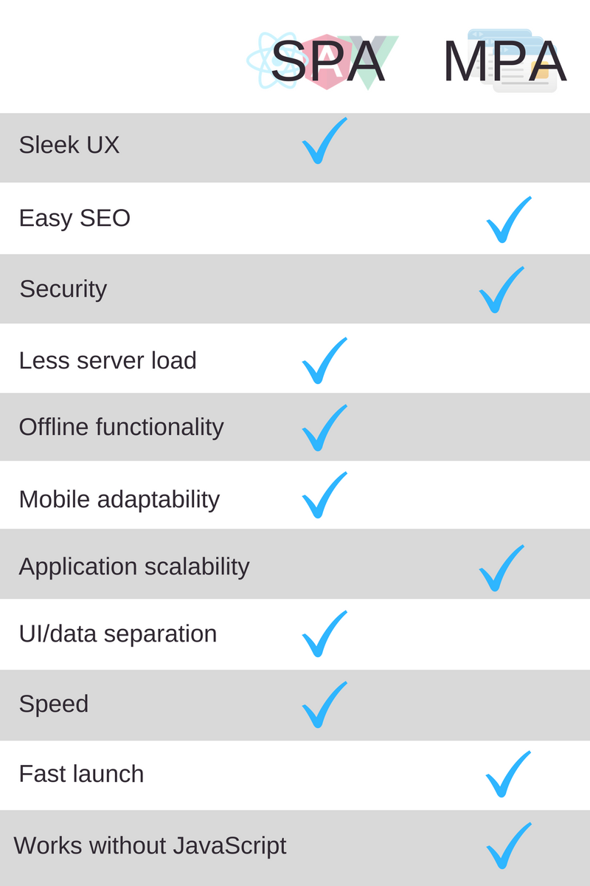

Slide 15
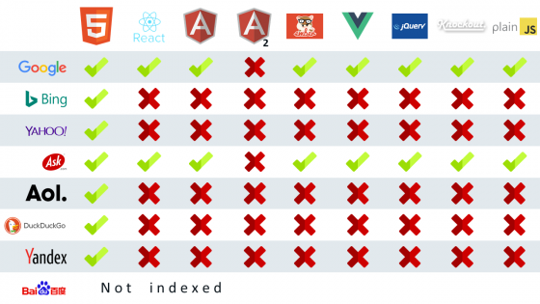
Single Page Application - Drawbacks
SEO Issues
For a long time, Google and other search engines had troubles with indexing SPAs. Their bots were good at crawling static HTML pages but were ill-equipped to render the dynamic content. And without the ability to execute JavaScript, all they saw in an SPA was an empty HTML container.
As a result, single-page applications rarely made it to the top of the search results.
In the last couple of years, Google has become much better at indexing JavaScript.
Still, Google admits it sometimes can’t properly index single-page applications. Not to mention that other search engines haven’t yet achieved the same SPA-crawling prowess.

Slide 16
Single Page Application - Drawbacks
Memory Leaks
Event listeners used in SPAs can cause a loss of available memory on the user devices. Since your app is essentially a single page that never reloads, memory leaks get worse the longer SPA runs.
If you don’t pay enough attention to this problem during development, it can lead to significant slowdowns and quickly drain the device’s battery.

Slide 17
Single Page Application - Drawbacks
Security Issues
Cross-Site Scripting (XSS) makes SPAs a bit more vulnerable to hacker attacks. XSS allows trespassers to insert malicious client-side scripts into otherwise trusted applications.
But there are ways to combat Cross-Site Scripting. With single-page applications, you can secure your data endpoints and separate the JS that gets downloaded by a client into multiple isolated pieces.
This way, attackers won’t be able to access all your code at once.

Slide 18
Single Page Application - Drawbacks
Slow first load
SPAs launch slower than the traditional applications. This happens due to client-side rendering. Before your browser can render the page, it has to load bulky JS frameworks. This could take a while, especially for the large application.
But after the first render, SPAs become much faster than MPAs.
Fortunately, there are ways to speed up the SPA initialization such as loading assets dynamically and minimizing the scripts.

Slide 19
Single Page Application - Drawbacks
Limited functionality with JavaScript Disabled
A small percentage of users disable JavaScript in their browsers. The reasons range from increased speed to security concerns. For such people, your cutting-edge SPA would be downright unusable.
The partial solution for this problem is to use server-side rendering for the first load. Still, some of your app’s functionality may remain unavailable with the JS disabled.
Progressive enhancement philosophy also allows you to create applications that deliver a satisfying experience to people who, disable JavaScript, or use outdated browsers and hardware.
Notes:
Now you see why single page applications became so popular recently. But before you pick your side in the SPA vs MPA debate, consider what you want to achieve.
If you aim to offer multiple services or different categories of goods, then creating a website with multiple pages is the logical solution. That’s why enormous applications like Amazon are built this way.
MPAs are also a good idea for websites that have a lot of content (such as news portals) and require flawless SEO.
If you, instead, wish to focus on promoting a single product or service, SPAs are a way better solution. They allow you to pack impressive functionality into a lightweight application. The superior UX makes SPAs ideal for porting highly interactive desktop applications and creating native-like experiences on the web.
That’s why CRM/ERP systems and interactive dashboards in SaaS products are often built as single-page apps.
All in all, SPA is an awesome tech. It offers many advantages and you can easily overcome its few cons with a qualified development team.

Slide 20
Questions?

